Slide 1







Making the world green one BIOplastic at a time
Arcemo, Micaella
Quimio, Christine
Robles, Ronnel
Tolentino, Nicole
LPU - Laguna
Notes:
#2b5adc, #ffffff, #242424, #2b5adc, #ffffff, #ef5747

Slide 2
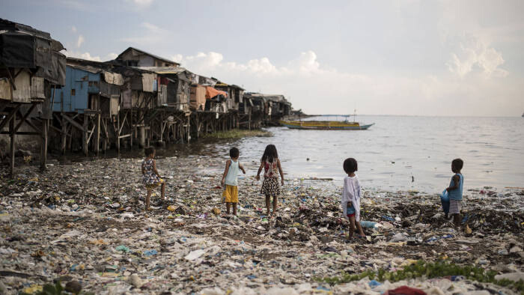

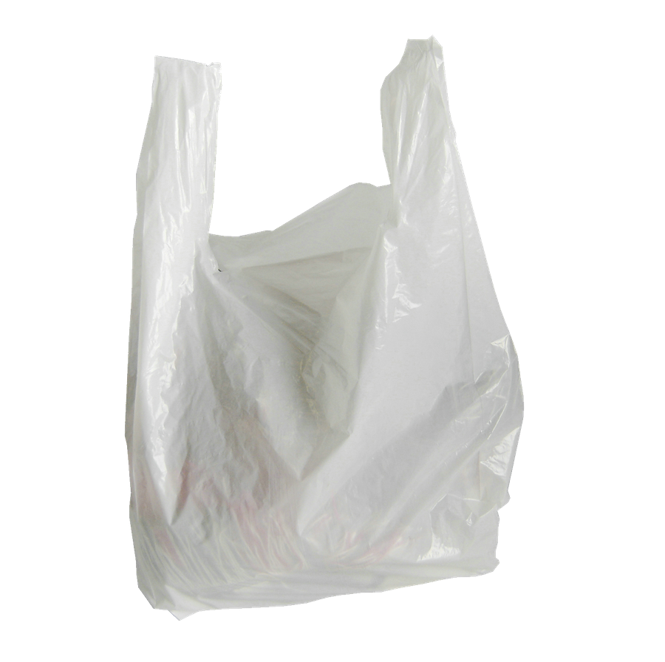
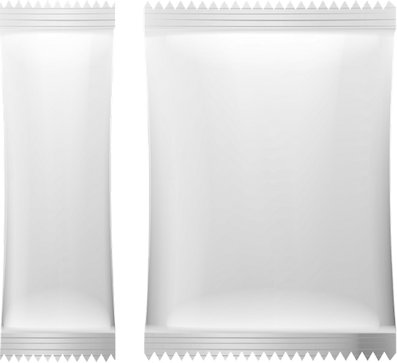

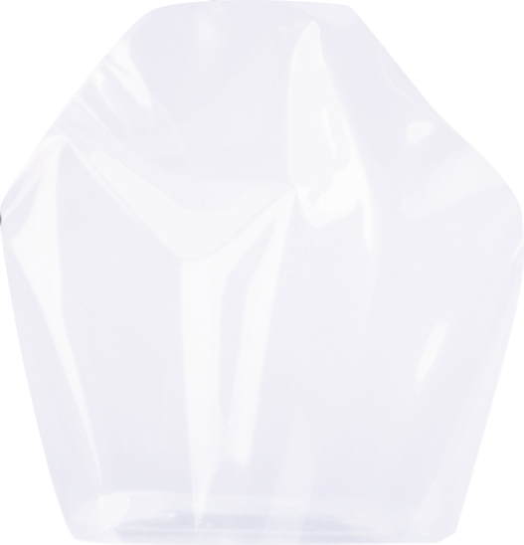
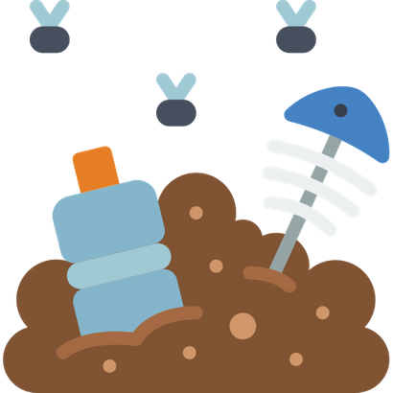

Problem #1
Over
256M
plastic items get thrown out on a daily basis.
(Gaia, 2019)
163 million
packet sachets
48 million
packet sachets
45 million
packet sachets

Slide 3
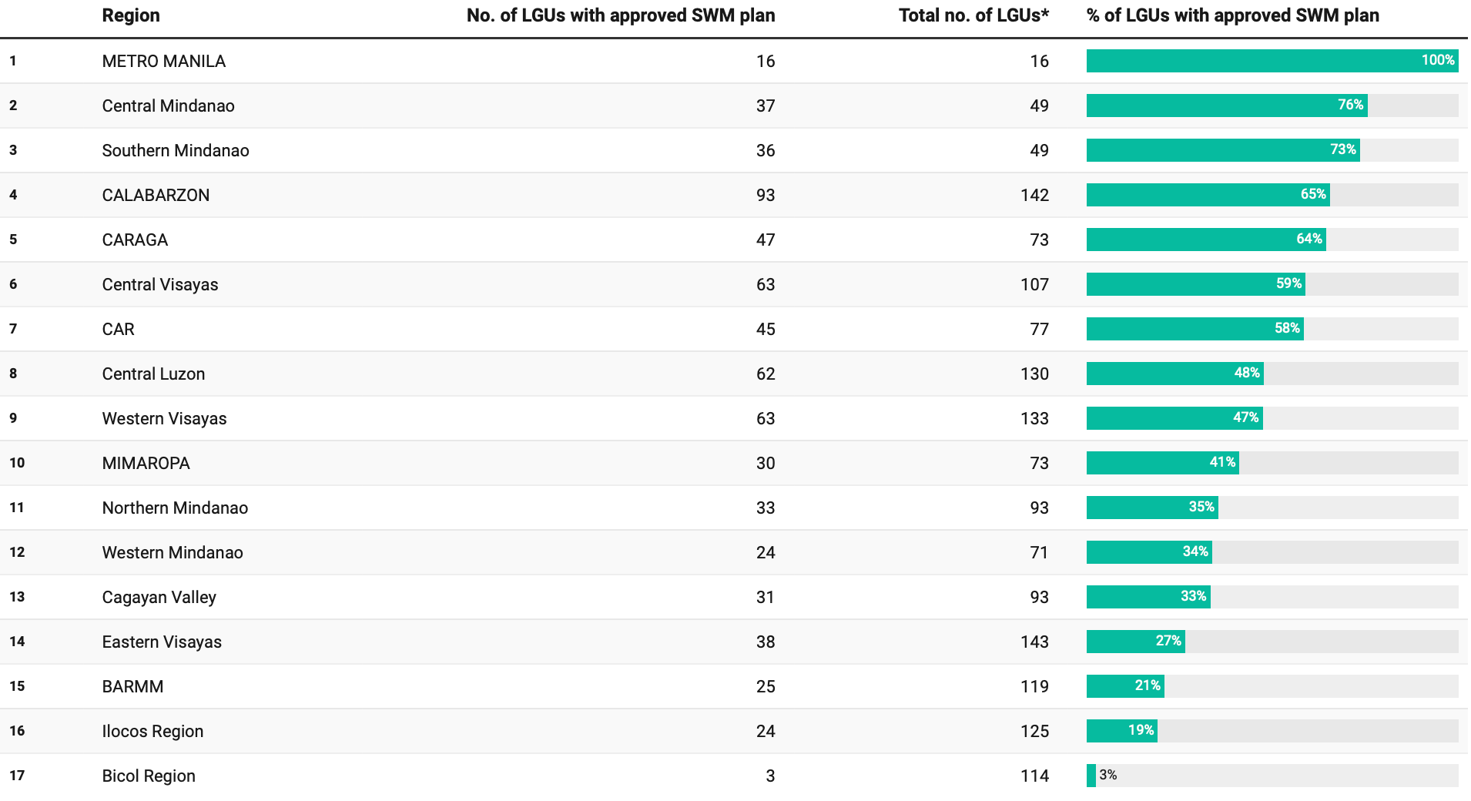



Approved 10-year solid waste management plan
119
LGU's
LGU's with SWM plan
25
21% ratio
(3rd to the last in the country)
* Based on the Philippine Standard Geographic Code, as of March 2019
Source: National Solid Waste Management Commission

Slide 4
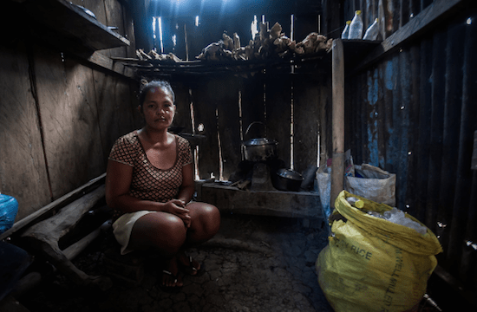


Problem #2
About
2M
people in BARMM are considered poor.
(Dy, 2019)

Slide 5
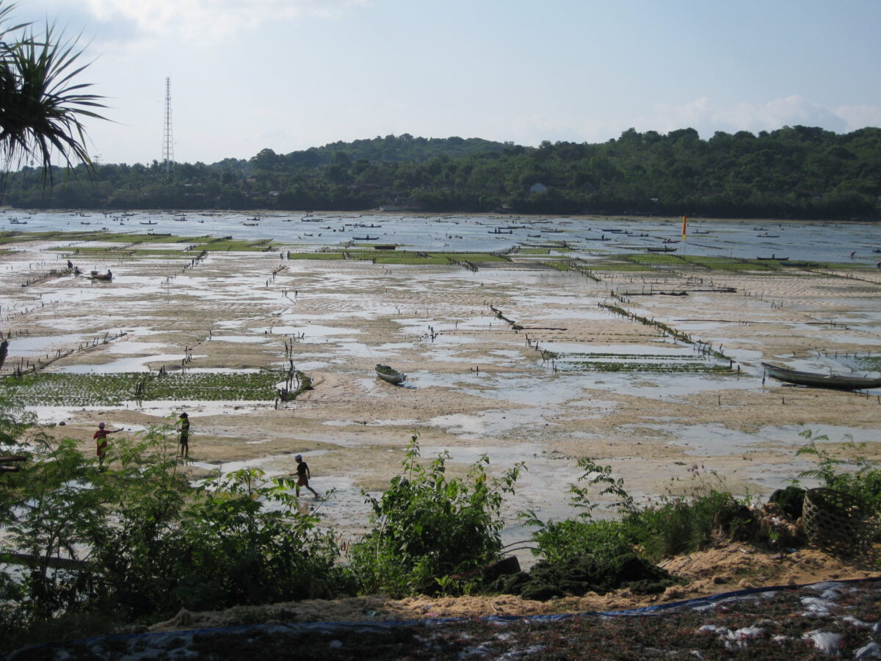


However,
BARMM captures
63.8%
of the total aquaculture production in the country.
(PSA, 2019)

Slide 6
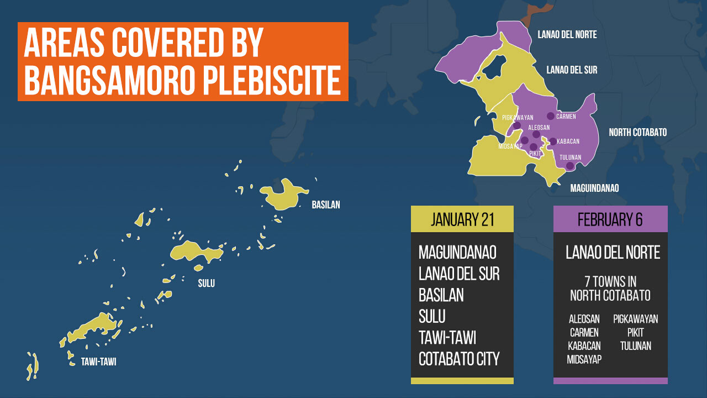



49.5% share
Tawi-Tawi has the highest concentration of aquaculture production in the region.
(PSA, 2019)

Slide 7
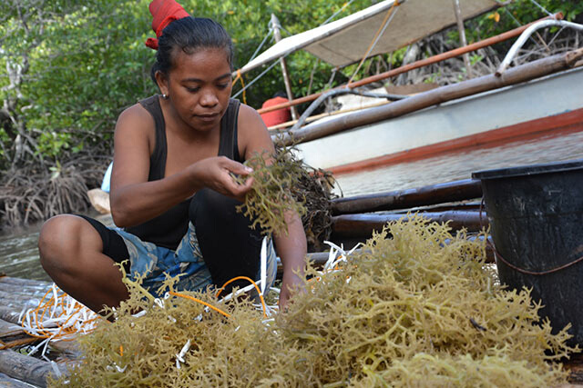
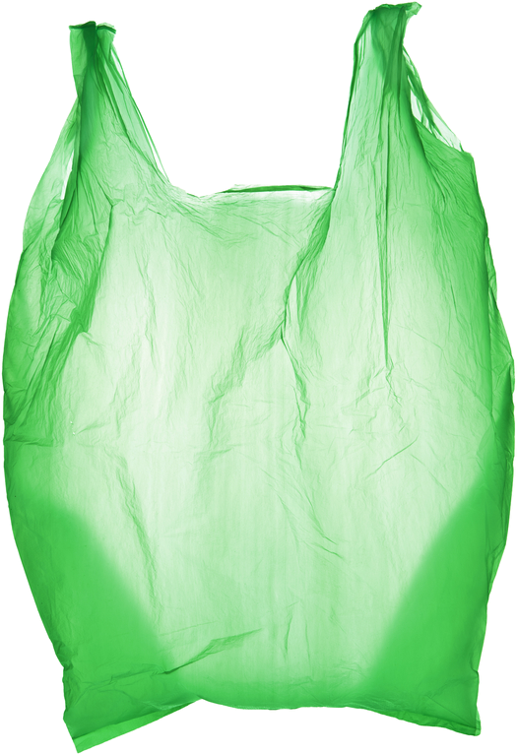





Solution
Eco-friendly
Safe
Non-toxic
Seaweed Bioplastics
Low
Maintenance
Affordable

Slide 8
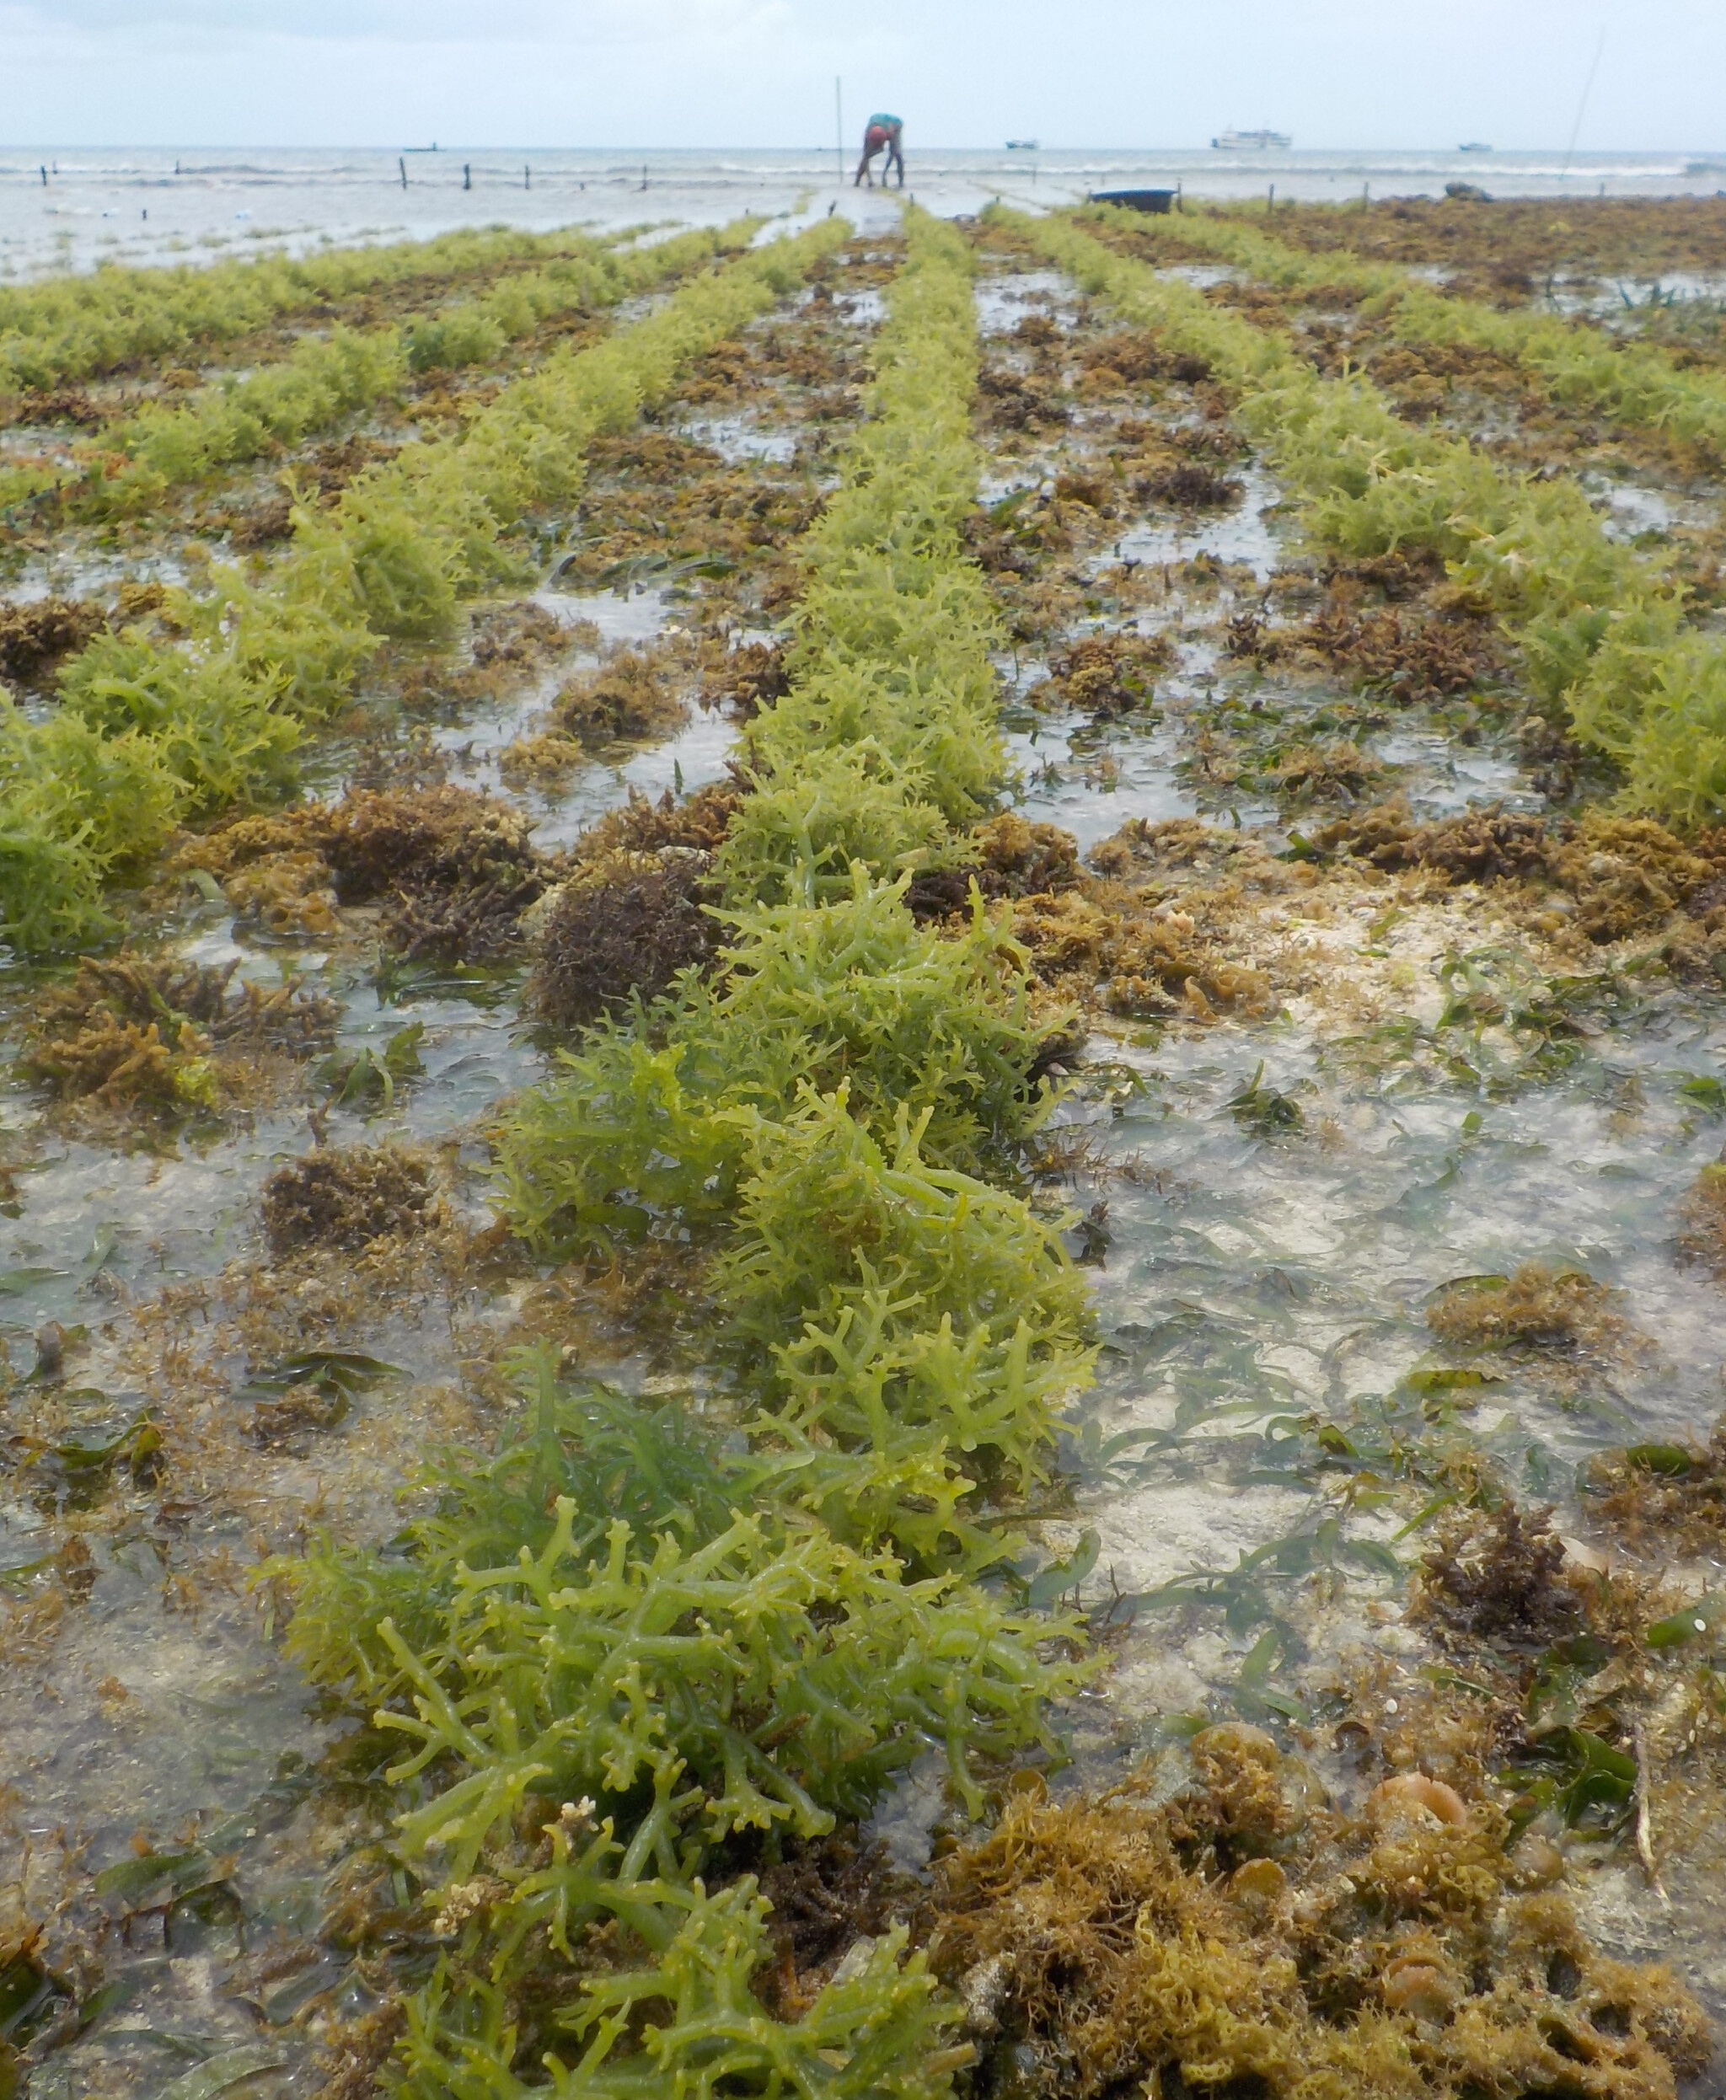
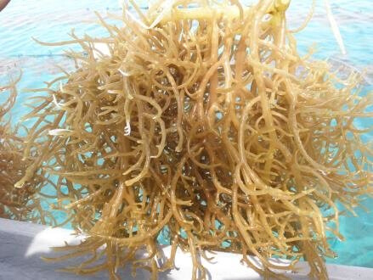
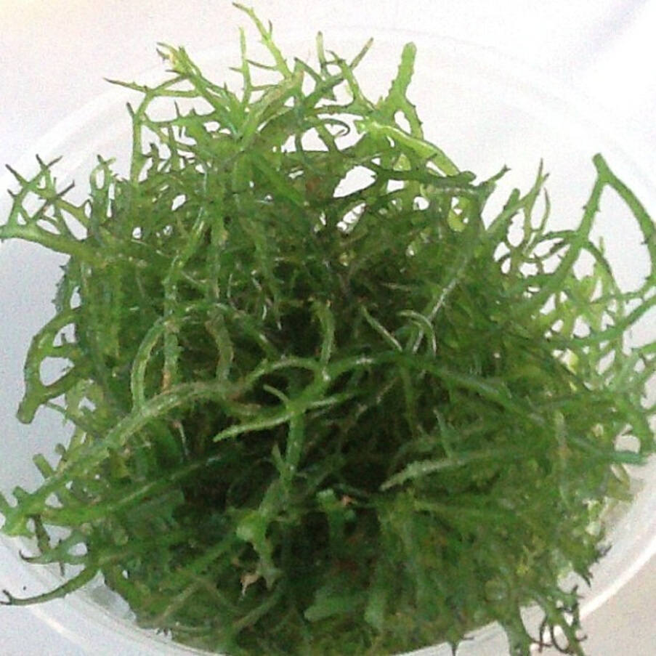



Components:
Water
Corn starch
Tambalang / Guso
Collagen
As provided by the Professionals group at Omar bin AbdulAziz Secondary Independent School

Slide 9
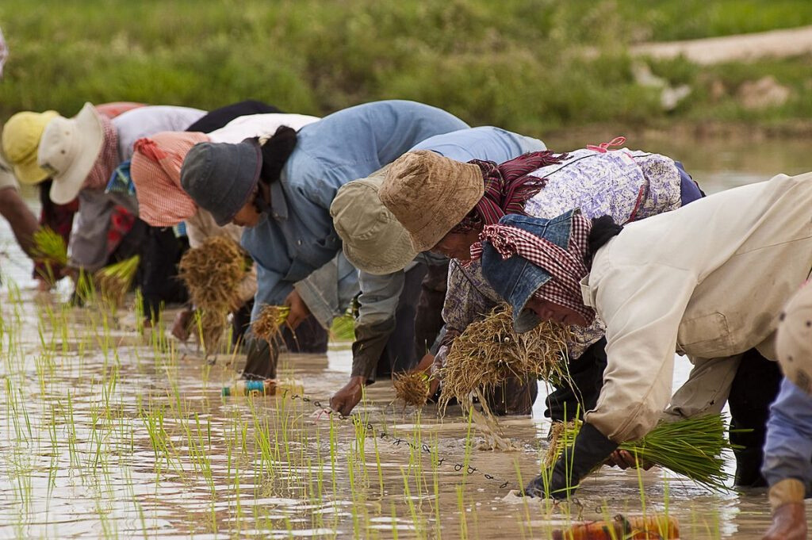
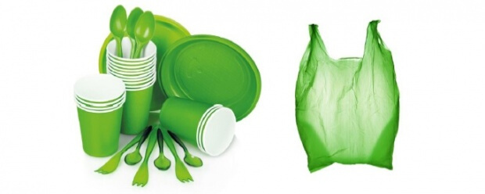

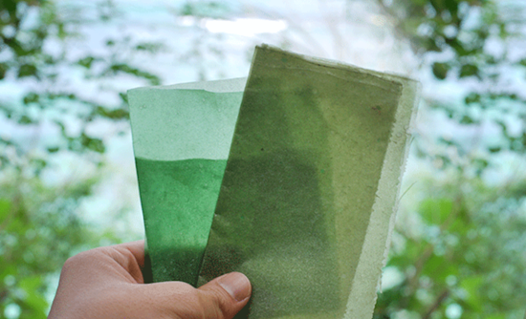
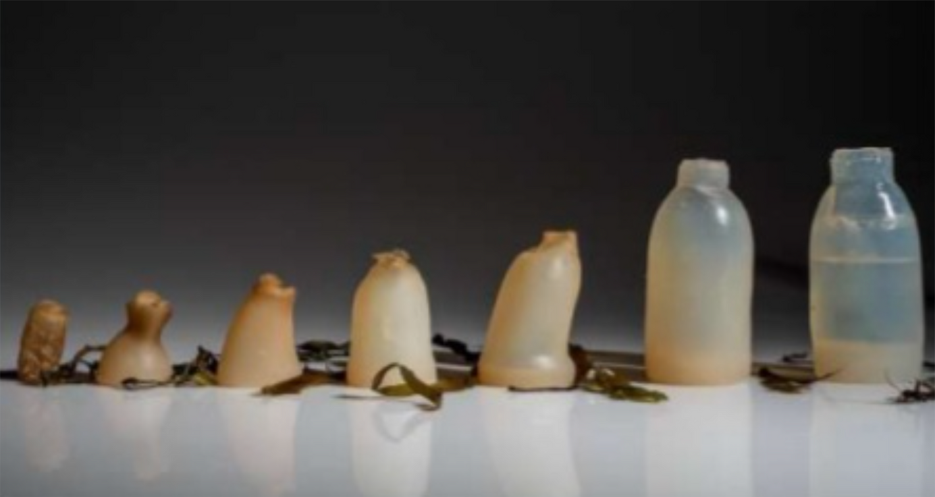
Possibilities
Utensils
Wrapping
Plastic bottles

Slide 10
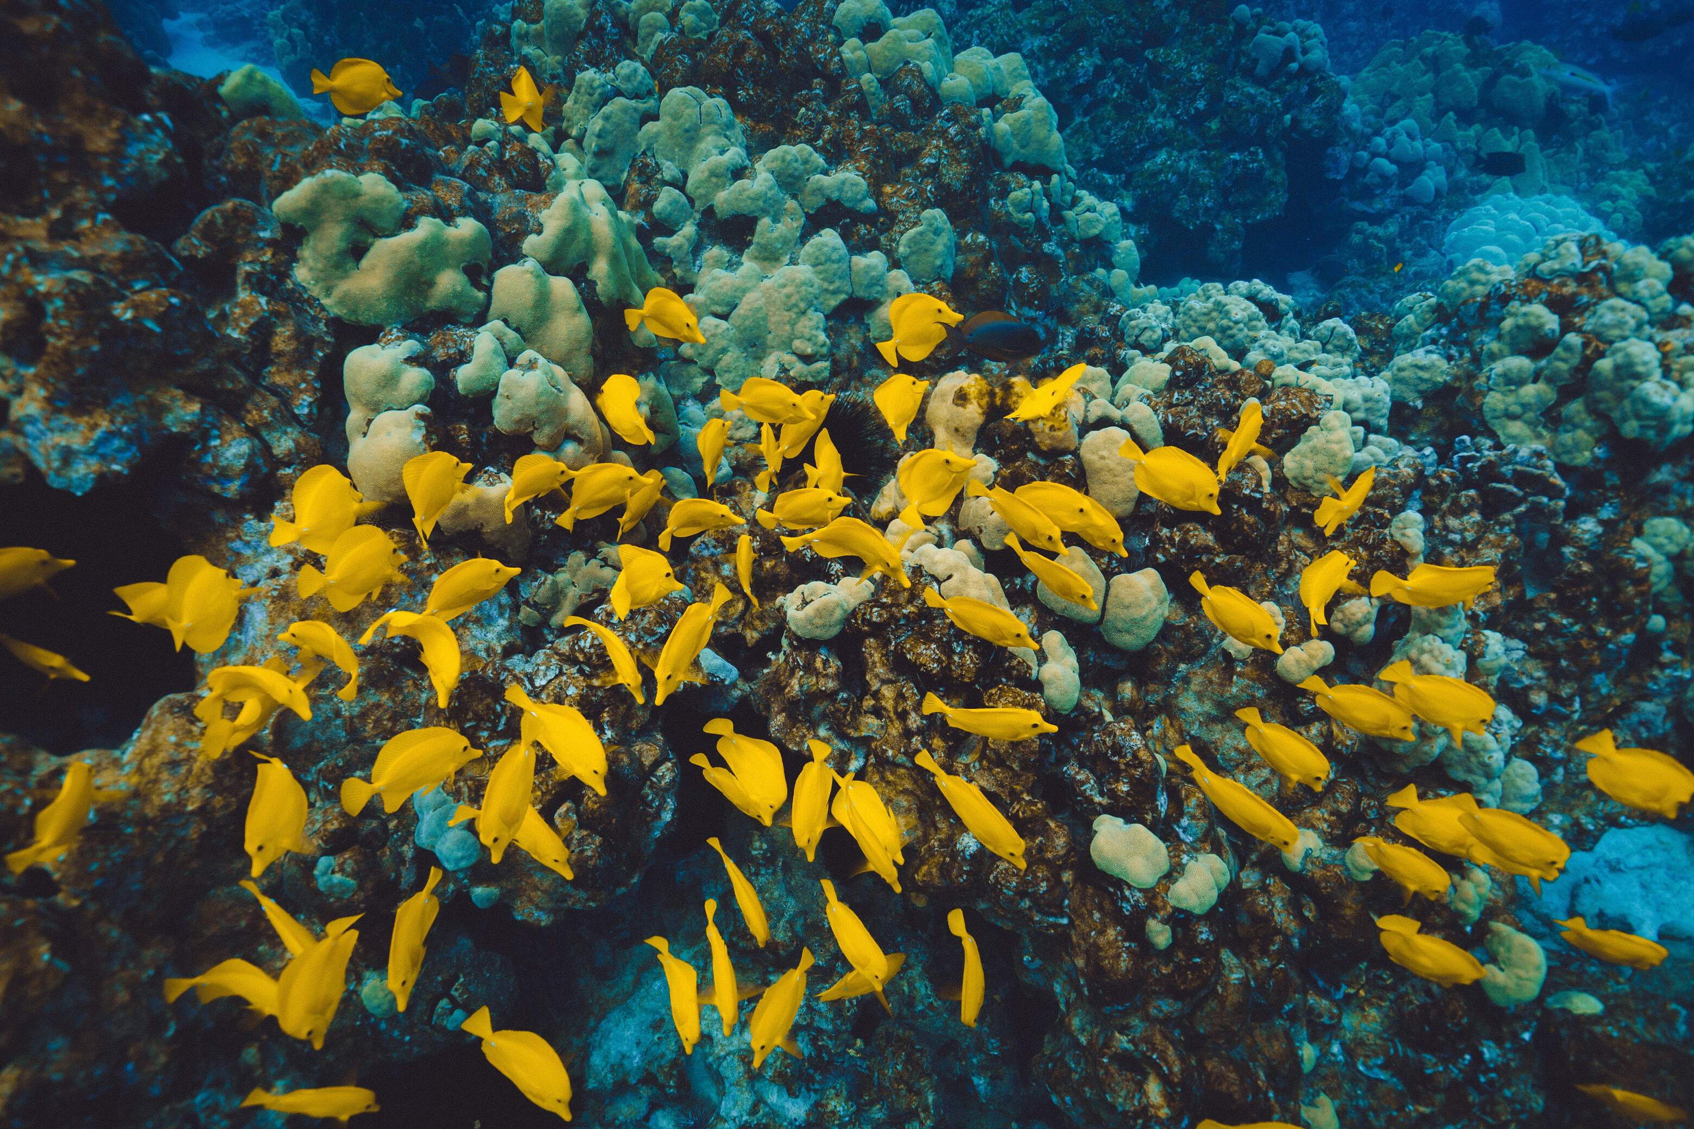



How is it different
from the others?
The bioplastic dissolves in water and it can be a sustainable source of income for the people.
(RFI, 2019)

Slide 11
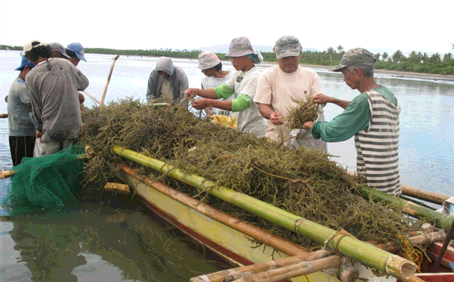




Business Opportunity
Long background with Seaweed Farming
Create local job opportunities
Potential to expand economic growth

Slide 12

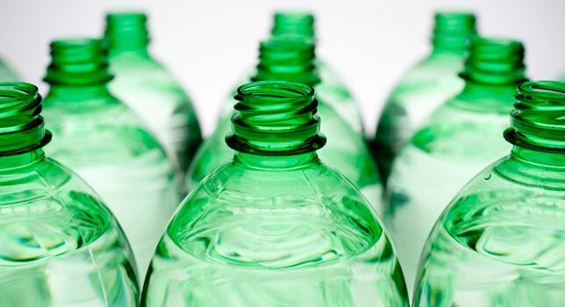
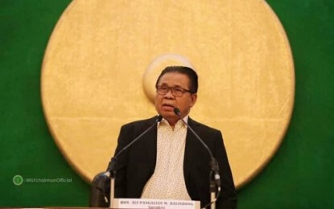

Timing
Plastic Bag Ban in BARMM offices
Market Size Potential Growth
The global biodegradable plastics market size is projected to reach USD 6.73 billion by 2025
By the use of seaweed bioplastics, businesses will still be able to provide convenient and cheap packaging to customers that will not let businesses disobey the law.
(Research and Markets, 2018)
(Policar, 2019)

Slide 13
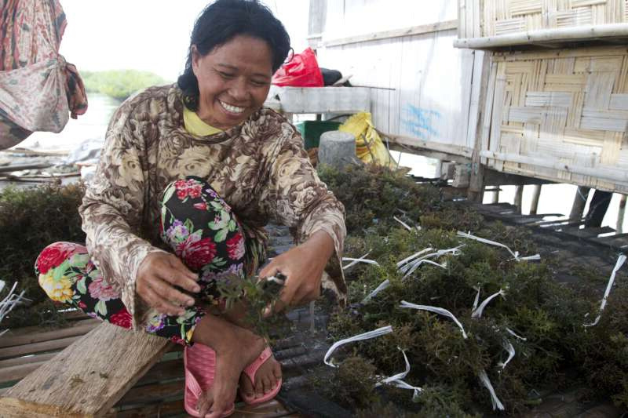

Conclusion
Seaweeds are a viable source for creating bioplastics
It will help reduce risk of plastic crisis globally
It will raise the economic activity of BARMM

Slide 14
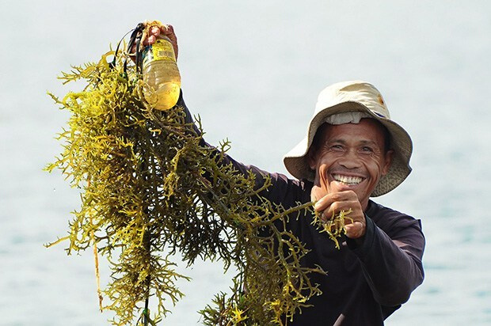

Get In Touch With Us
Company Address
KM. 54 National Hi-way, Makiling, Calamba City, Laguna
Phone Number
(049) 502 8946
Website
lpulaguna.edu.ph

Slide 15
References
BPI-ARMM (2017). Seaweed Farmers Struggle as the Seaweed Industry Grows. AGRICULTURE. Retrieved on February 5, 2020 from http://www.ndbcnews.com.ph/news/seaweed-farmers-struggle-seaweed-industry-grows
Dy, R. T. (2019, January 28). The poverty challenge of Bangsamoro. Retrieved from https://business.inquirer.net/264224/the-poverty-challenge-of-bangsamoro
Fernandez, I., Baunto, A., & Villasper, J. (2019). Open Data for the Bangsamoro Transition Practical Notes on Using Geospatial and Statistical Data for Decision-Making. The Asia Foundation, 1-23. DOI: 10.13140/RG.2.2.32445.41445
Fernandez, H (2015). Tawi-Tawi Seaweed Farms. Retrieved on February 5, 2020 from https://indaydiaries.wordpress.com/2015/06/17/tawi-tawi-seaweed-farms/
Gaia. (2019, March 8). Plastics Exposed: How Waste Assessments and Brand Audits are Helping Philippine Cities Fight Plastic Pollution. Retrieved from https://www.no-burn.org/waba2019/
Macaraeg, P. (2019). How Going Zero Waste is Addressing PH's Plastic Pollution. Rappler PH. Retrieved on February 5, 2020 from rappler.com/science-nature/environment/239891-how-going-zero-waste-address-philippines-plastic-pollution
Policar, D. (2019, July 2). Single-use plastic banned in BARMM government offices. Retrieved from https://www.pressreader.com/philippines/bandera-mindanao/20190702/281547997439631
Research and Markets. (2018, November 5). Global Biodegradable Plastics Market Report 2018-2025 - Market Size is Projected to Reach USD 6.73 Billion. Retrieved from https://www.globenewswire.com/news-release/2018/11/05/1645081/0/en/Global-Biodegradable-Plastics-Market-Report-2018-2025-Market-Size-is-Projected-to-Reach-USD-6-73-Billion.html
RFI. (2019, August 8). Young scientist creates bio-plastic from mango peels and seaweed. Retrieved from https://www.rfi.fr/en/asia-pacific/20190807-philippines-scientist-bio-plastic-mango-peels-and-seaweed-environment-science
UNDP (2016). Coordinator for BARMM and Marine Plastic Litter. Retrieved on February 5, 2020 from https://jobs.undp.org/cj_view_job.cfm?cur_job_id=86182

